Slide 1
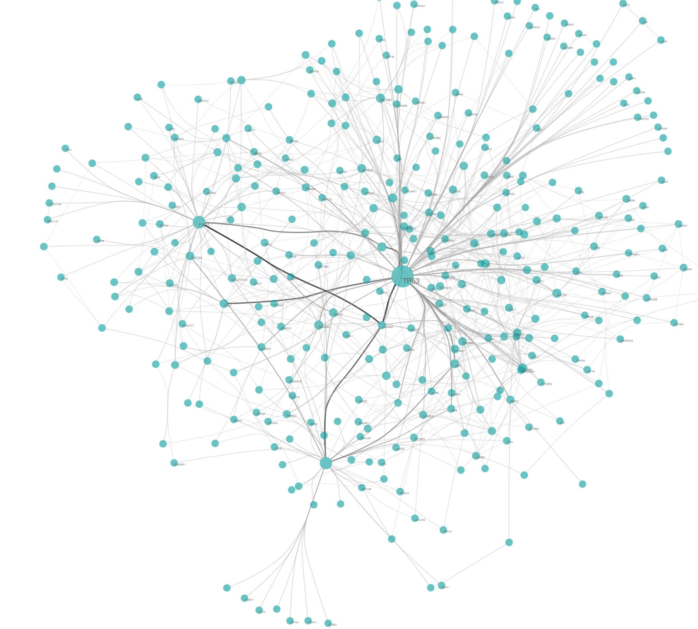
Biological Network Analysis
Hannah Carter
UCSD Department of Medicine
02/21/2019
hkcarter@ucsd.edu

Slide 2
Properties of Biological Networks
Scale Free
Generally see a small number of highly connected hubs and a much larger number of less connected nodes
Fault tolerance – essential nodes less likely to be “attacked” by random error
Small world
Most nodes in biological networks are not that distant from one another
Evolutionary advantage – deleting a node generally doesn’t greatly increase the mean shortest path length
Modular
Guilt-by-association: Neighboring nodes in biological networks are usually involved in the same biological function

Slide 3
Overview
Day 1: Introduction to networks
Why networks?
Network basics & examples of biological networks
What networks can teach us about biological systems
Challenges for biological network analysis
Introduction to Cytoscape and Ndex
Loading and visualizing networks
Day 2: Network analysis
Statistical hypothesis testing with networks
Motif detection
RNA seq data analysis

Slide 4
Statistical Problems on Graphs
Network analysis in a hypothesis testing framework
Any claim should be compared against a null model
Examples of claims:
A motif is over-represented
Differential gene expression is enriched in regions of the graph
Groups of functionally associated nodes are more densely connected, or enriched in a particular niche (e.g. hubs, bottlenecks)
Theoretical null models are often not available or inappropriate
observations or scores derived based on network data not usually "independent" samplings from populations
Violates assumptions of many statistical tests
Alternative: Need an empirical null model

Slide 5
Randomization strategies
Need to generate an empirical null model for statistical hypothesis testing
Would you see a statistic as extreme as t in a random network?
Use randomization to break the association between measurements and phenotypes
Randomize edges – lose the structure
randomly reassign values in adjacency matrix
Randomize nodes – preserve the degree structure but doesn’t retain structure to gene relationships
Shuffle node IDs
Preserves node degrees for the network as a whole, but not for individual nodes
A
B
C
D
E
A
1 | 0 | 1 | 1 | 0
0 | 0 | 0 | 1 | 1
1 | 0 | 1 | 0 | 0
0 | 1 | 1 | 1 | 1
0 | 1 | 0 | 0 | 1
B
C
D
E

Slide 6
Degree Preserving Permutation
Preserves structure and gene-specific degree
Most conservative randomization
Both nodes and whole graph retain same properties but biological relationships between nodes are randomized
A
B
C
D
E
A
1 | 0 | 1 | 1 | 0
0 | 0 | 0 | 1 | 1
1 | 0 | 1 | 0 | 0
0 | 1 | 1 | 1 | 1
0 | 1 | 0 | 0 | 1
B
C
D
E
Corresponds to a new adjacency matrix where the row and column sums are the same as the original.

Slide 7
Random Graphs
Comparing to random graphs has been useful for gaining insight into biological systems, but are less useful as null models for
Original Erdos-Renyi (not widely used)
Given n vertices, all possible graphs with k edges – choose a graph at random
Exactly k edges
Erdos-Renyi (1960) / Gilbert (1959)
Given n vertices, two vertices are connected by an edge with a probability p
On average k edges, with the actual number following a probability distribution
Barabasi-Albert (1999)
Preferential attachment model
Probability of attachment depends on relative degree of node k
Notes:
Barabasi, A.-L. and Albert R. 1999. Emergence of scaling in random networks Science, 286 509–512.

Slide 8
Exercise: Random networks in iGraph
Jupyter Notebook: Exercise 3

Slide 9
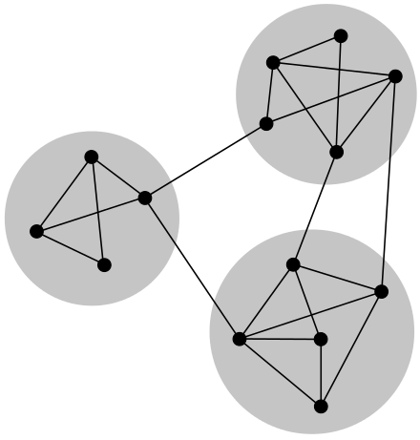
Algorithmic Problems on Graphs
Graph partitioning
Module/community finding
Clique/motif counting
Shortest path in a weighted or directed graph

Slide 10
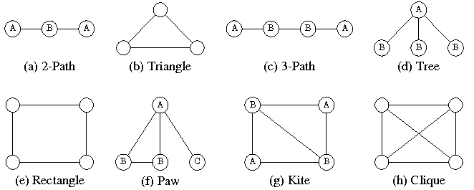
Motifs in graphs
Motifs
Subgraphs that occur within a larger graph

Slide 11
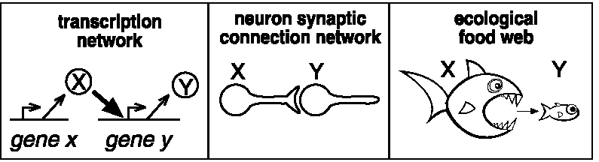
Example: Motif searches in 3 different contexts
How many motifs (connected subgraph topologies) exist involving three nodes?
If the graph is undirected?
If the graph is directed?

Slide 12
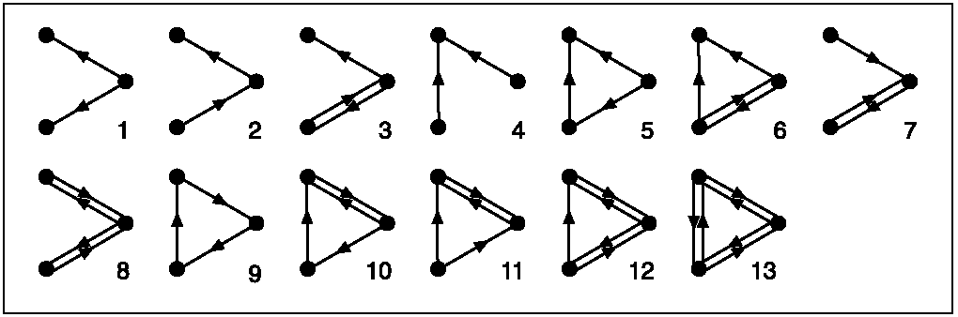
All 3-node directed subgraphs
What is the frequency of each in the network?
Are any of these motifs overrepresented? (would suggest function)

Slide 13
Outline of the Approach
Search network to identify all possible n-node connected subgraphs (here n=3 or 4)
Get # occurrences of each subgraph type
The significance for each type is determined using permutation testing, in which the above process is repeated for many randomized networks (preserving node degrees– why?)
Use random distributions to compute a p-value for each subgraph type. The “network motifs” are subgraphs with p < 0.001 (why?)

Slide 14
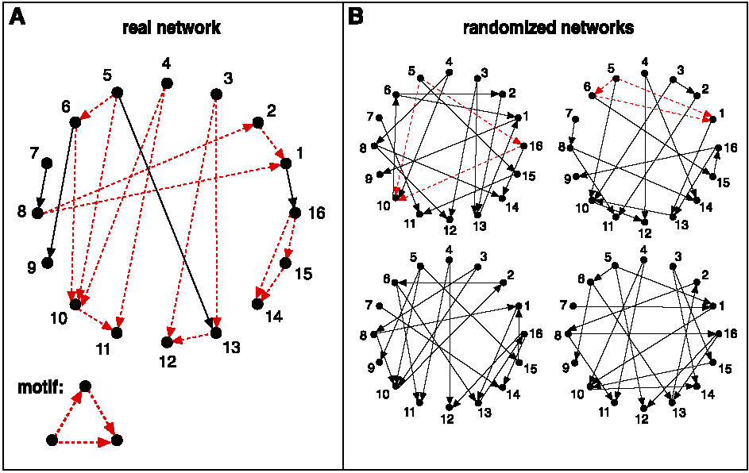
Schematic view of network motif detection
Networks are randomized preserving node degree

Slide 15
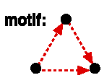
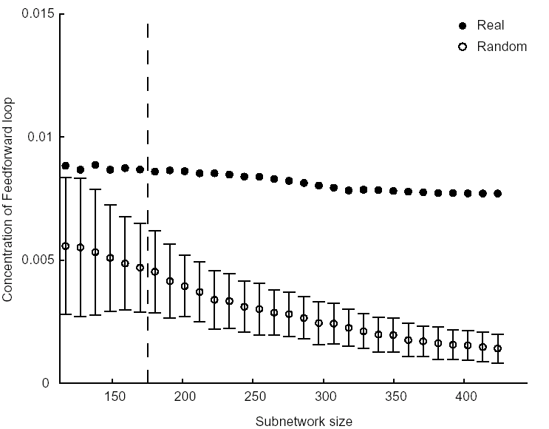
Concentration of feedforward motif:
(Num. appearances of motif divided by all 3 node connected subgraphs)
Mean+/-SD of 400 random subnetworks

Slide 16
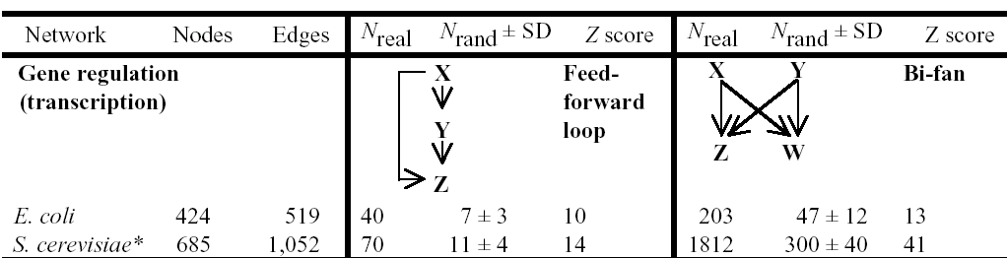
Transcriptional network results

Slide 17
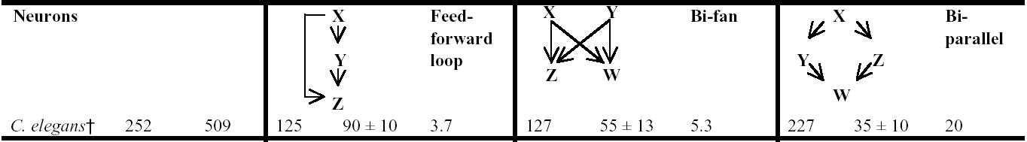
Neural networks

Slide 18
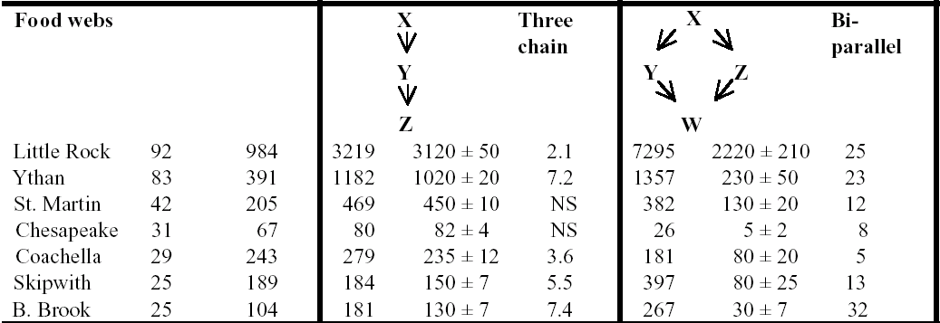
Food webs

Slide 19
Interesting questions
Which networks have motifs in common?
Which networks have completely distinct motifs versus the others?
Does this tell us anything about the design constraints on each network?
E.g., the feedforward loop may function to activate output only if the input signal is persistent (i.e., reject noisy or transient signals) and to allow rapid deactivation when the input turns off
E.g., food webs evolve to allow flow of energy from top to bottom (?!**!???), whereas transcriptional networks evolve to process information
Notes:
feed forward loop & bifan commonly act as AND/OR gates depending on activating/inactivating activity of nodes
Top-down control => Abundance/biomass of lower trophic levels depends on effects of consumers at higher trophic levels

Slide 20
Exercise 4: Motif finding in iGraph
Jupyter Notebook: Exercise 4

Slide 21
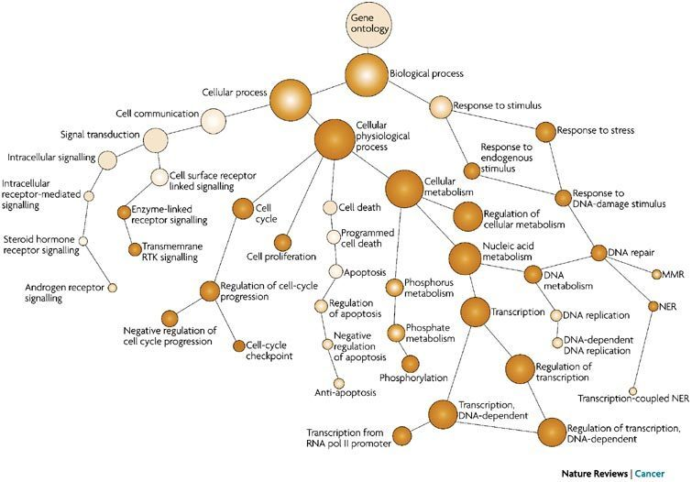
Ontologies
Define a hierarchy among objects
Gene Ontology (GO)
Curated from scientific literature
Other examples
Disease – symptom relationships
Organ – tissue – cell-type relationships

Slide 22
Modularity of Graphs
Cliques
A set of nodes that are all directly connected to one another
“Complete” subgraph of G

Slide 23
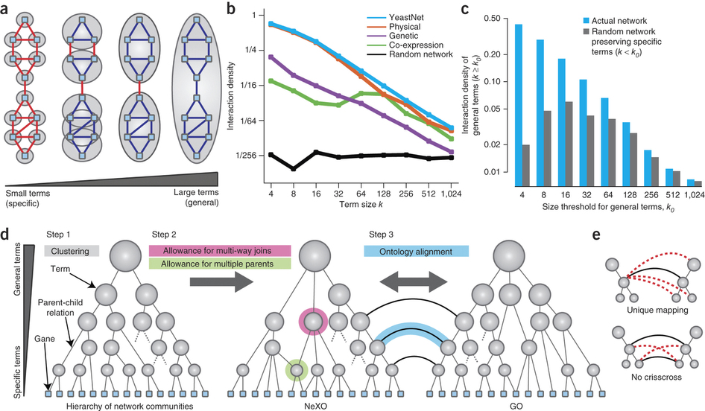
Constructing Ontologies from High-throughput Data

Slide 24
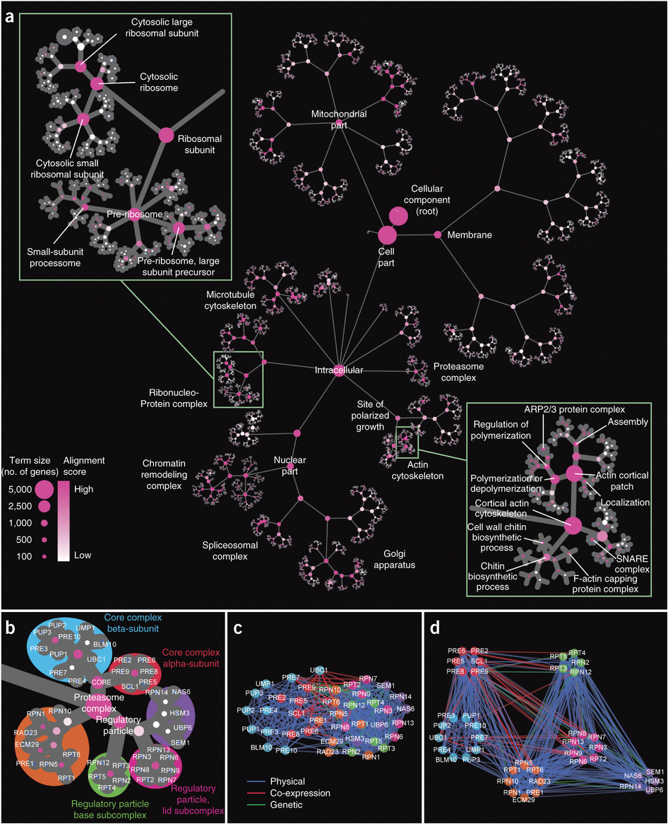
NEXO for Yeast
Nature Biotechnology (2013)

Slide 25
Network Analysis of Gene Expression Data

Slide 26
Networks And Gene Expression
Common Applications
Use networks to analyze differential expression data
Identify differentially expressed pathways
Identify network biomarkers
Use expression data to construct a network
Connect genes with similar expression patterns in a network
Relate gene co-expression modules to traits or diseases

Slide 27
Use a network to analyze differential expression data
1) Select network
2) Map differential expression statistics onto network
3) Identify network regions that are enriched for differentially expressed genes

Slide 28
Need a scoring system for expression activity
Each node in the network assigned a differential expression fold-change (usually log scale) and significance (p-value)
Can generate an aggregate z-score for a set of nodes
Expression fold-changes can be misleading

Slide 29
Analysis of gene expression with pathway scores
Zien, Kuffner, Zimmer, Lengauer (2000) originally proposed a method for scoring gene expression activity of a given metabolic reaction pathway P:
S(G) is a p-value of differential expression or an average correlation coefficient vs. genes in P
More recently, statistics have been modified to use z-scores
(e.g. Stouffer’s Method – JActiveModules)

Slide 30
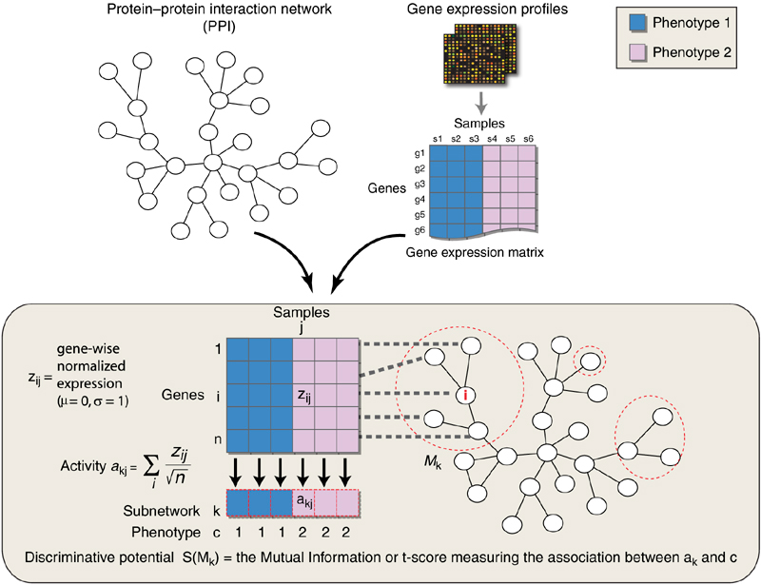
Network Modules as Biomarkers
Identify differential gene set activity in two conditions.
Constrain gene set search space based on network structure.
Chuang HY et al. Network-based classification of breast cancer metastasis Mol Syst Biol. 2007;3:140.
Notes:
Get per patient subnetwork activity scores
Look at mutual information between activity scores and patient phenotypes
Compare discriminative potential to random networks
Subnetworks based on seed and expand greedy search over network neighborhoods to maximize subnetwork score
0) Methods take advantage of properties of biological networks – for example modularity
1) For example, Chuang et al used networks to constrain the search space over gene expression profiles for groups of differentially expressed genes
2) These ‘subnetwork’ biomarkers are more reproducible than individual genes

Slide 31
Searching for “active” pathways in a large network
Score subnetworks according to their overall amount of activity
Finding the highest scoring subnetworks is NP hard, so use heuristic search algorithm. to identify a collection of high-scoring subnetworks (local optima)
Simulated annealing and/or greedy search starting from an initial subnetwork “seed”
During the search we must also worry about issues such as local topology and whether a subnetwork’s score is higher than would be expected at random
Need to compare to scores on matched random networks
Notes:
So now that we have a scoring system, we can turn to the problem of finding the high-scoring pathways themselves.

Slide 32
Infer a Network from gene co-expression
Examples:
Weighted Gene Co-expression Network Analysis (WGCNA)
Soft threshold implemented by exponent Beta
High Beta drives low correlations to 0
Beta can be selected to return a scale free topology
ARACNE
Eliminate indirect interactions using mutual information
“defines an edge as an irreducible statistical dependency between gene expression profiles that cannot be explained as an artifact of other statistical dependencies in the network”

Slide 33
Correlation -> Adjacency
Essentially this is a sparse precision matrix estimation problem
Simple threshold (WGCNA)
hard vs soft
Probabilistic: Conditional Independence
Mutual information (ARACHNE)
L1 regularization (G-LASSO)
Note on covariance versus correlation
Both encode similarity across samples
covariance is appropriate when variables have the same scale (e.g. z-scored expression data)
correlation is better if the variables have very different scales (log2 expression)
Absolute versus signed correlation
It may be desirable to capture direction of similarity

Slide 34
Steps for constructing a co-expression network
Overview: gene co-expression network analysis
Gene expression data
Measure concordance of gene expression with a Pearson correlation
C) The Pearson correlation matrix is
1) dichotomized to arrive at an adjacency matrix → unweighted network (hard threshold)
or
2) transformed continuously with the power adjacency function → weighted network (soft threshold)

Slide 35
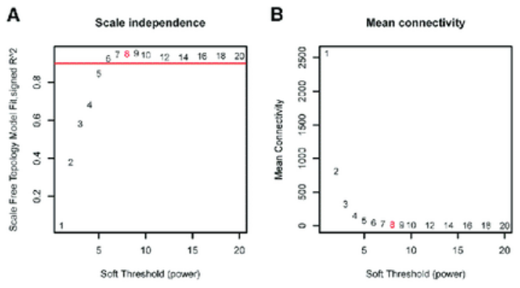
Power Adjacency Function
Soft thresholding
Notes:
Connectivity – has to do with number of connected components

Slide 36
Find clusters within the co-expression network
The topological overlap dissimilarity is used as input of hierarchical clustering
The topological overlap of two nodes reflects their similarity in terms of the commonality
of the nodes they connect to
Generalized in Zhang and Horvath (2005) to the case of weighted networks
Generalized in Yip and Horvath (2006) to higher order interactions
Notes:
aij represents a field in the adjacency matrix indexed by i,j
u indexes all genes in the network
1-aij prevents double counting
Ki is the degree of node i

Slide 37
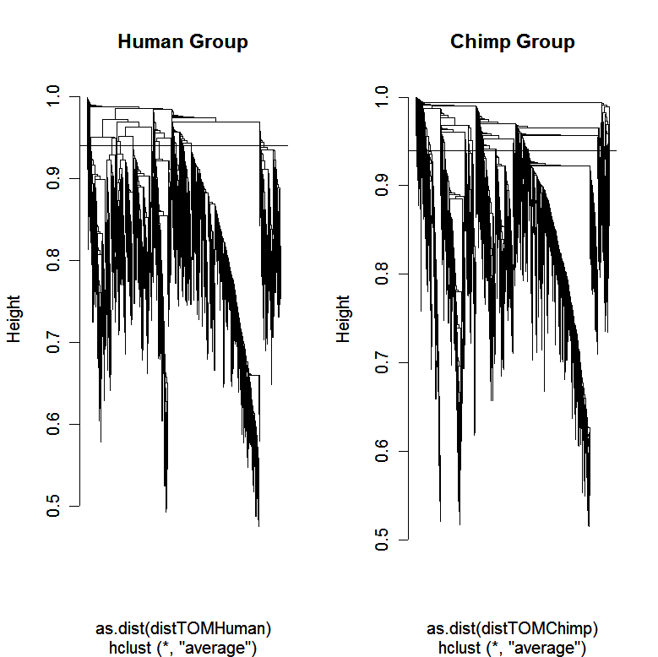
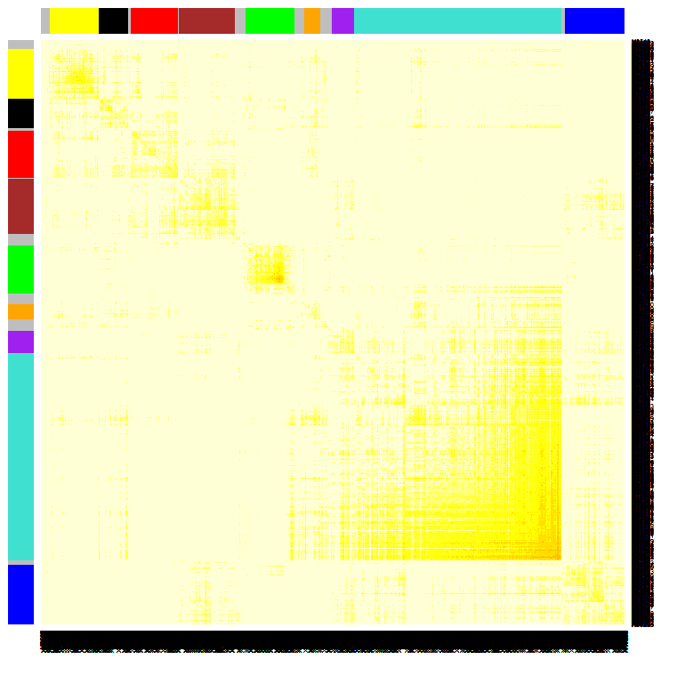
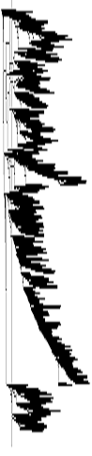
Using the topological overlap matrix (TOM) to cluster genes
Here modules correspond to branches of the dendrogram
TOM plot
Genes correspond to rows and columns
TOM matrix
Hierarchical clustering
dendrogram
Module:
Correspond
to branches

Slide 38
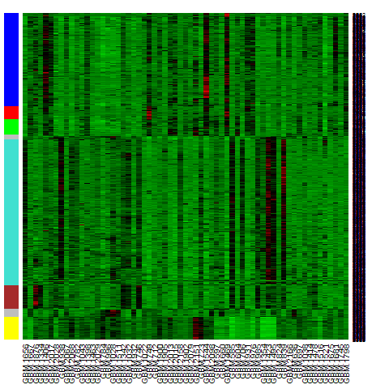
Heatmap view of module
Columns= tissue samples
Rows=Genes
Color band indicates
module membership
Message: characteristic vertical bands indicate
tight co-expression of module genes

Slide 39
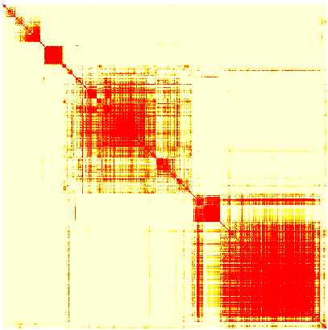
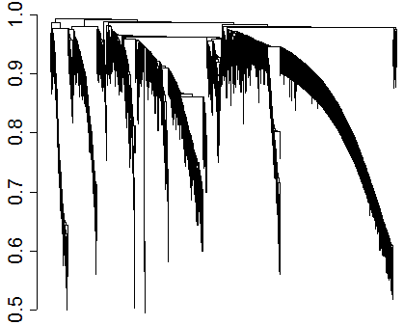
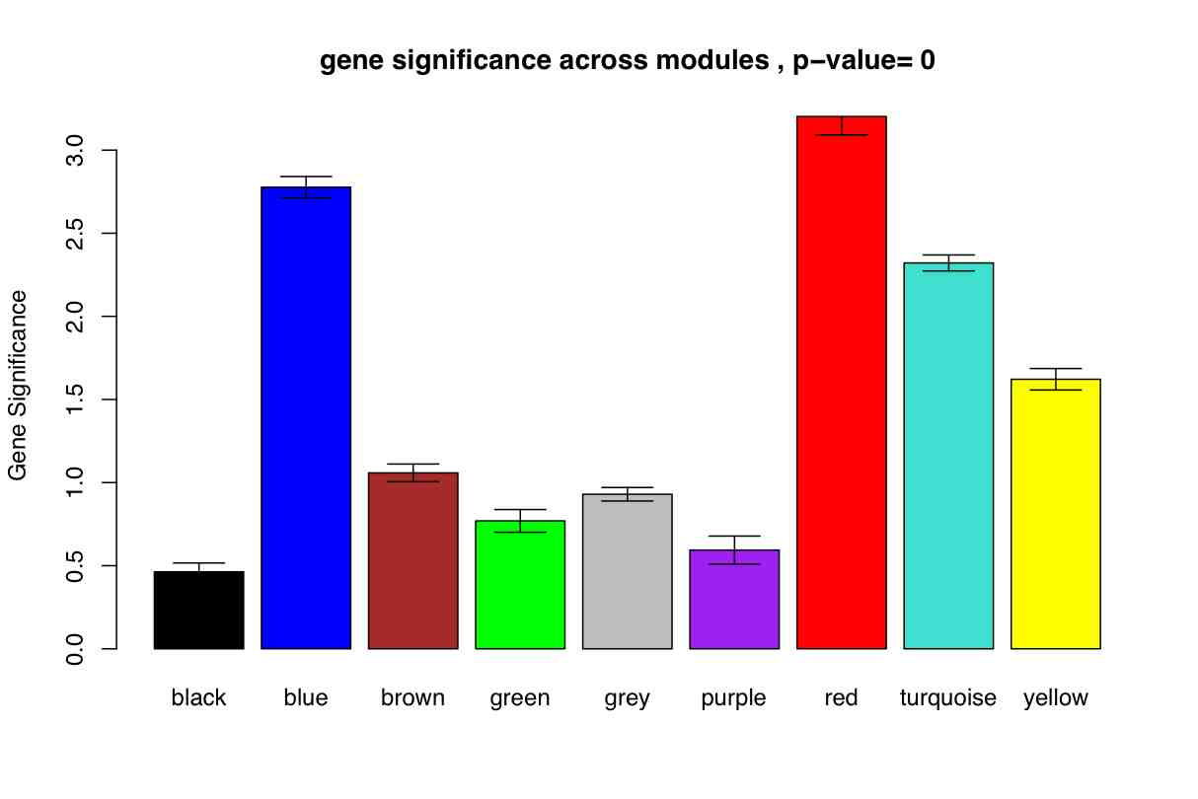
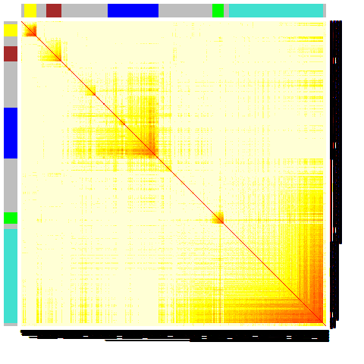
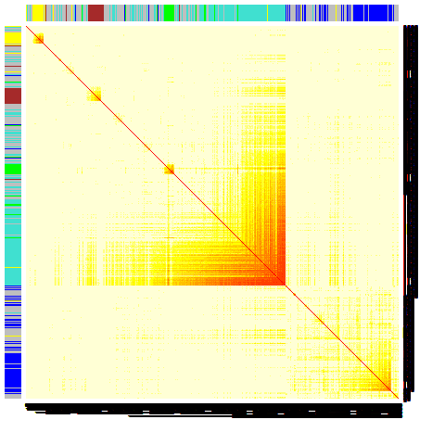
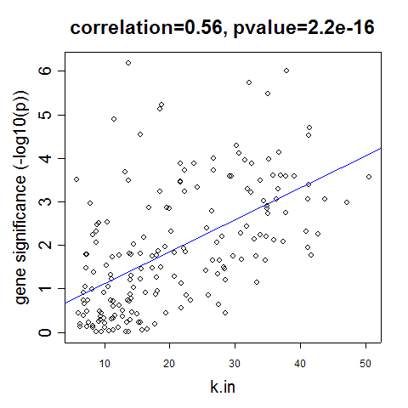
Construct a network
Rationale: make use of interaction patterns between genes
Identify modules
Rationale: module (pathway) based analysis
Relate modules to external information
Array Information: Clinical data, SNPs, proteomics
Gene Information: gene ontology, EASE, IPA
Rationale: find biologically interesting modules
Study Module Preservation across different data
Rationale:
Same data: to check robustness of module definition
Different data: to find interesting modules.
Find the key drivers in interesting modules
Tools: intramodular connectivity, causality testing
Rationale: experimental validation, therapeutics, biomarkers

Slide 40
Sources for Biological Network Data
http://www.ndexbio.org/#/
Interaction databases
STRING
MINT
HPRD
MIPS
BIND
GRID
DIP
HumanNet / YeastNet
Pathway Databases
Pathway Commons
Biogrid
NCBI PID
Reactome
Gene Ontology

Slide 41
Conclusions
Networks allow study of biological systems by modeling interactions between components
Careful consideration should go into network construction and analysis
Randomizations can be devised to create principled empirical null models
Numerous method exist to create and analyze networks
Important to think about implicit assumptions in each step and the resulting biological interpretations

Slide 42
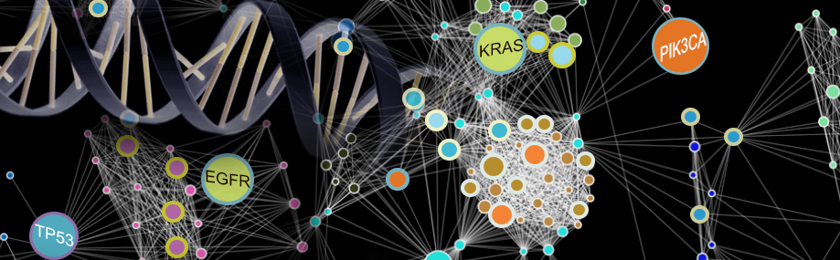
Thank you!

